Slide 1
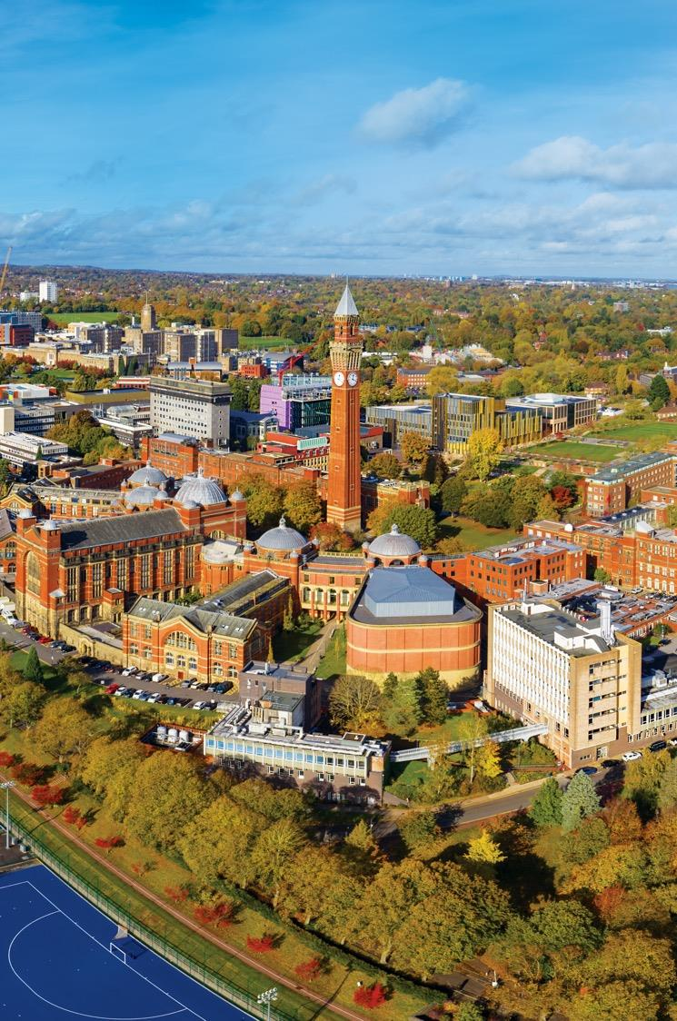

DRS - Jaundice
Tutorial
Lecturer: Dr Li Yueming
Acknowledgement: Prof. Trish Lalor
Dr. Rogelio M. Levardo Jr.

Slide 2
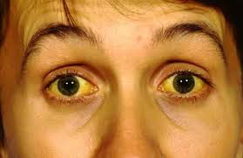
Jaundice
Jaundice
Where does bilirubin come from, and what causes jaundice?
Learning Outcomes
Understand jaundice and its causes.
Recognise how the nature of jaundice suggests possible causes.
Understand that jaundice is not always caused by liver dysfunction
From bilirubin metabolism to clinical diagnosis.

Slide 3
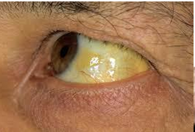
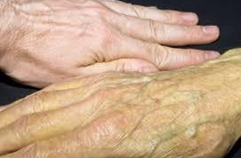
What Is Jaundice?
Jaundice = yellow discolouration
Yellowing of the skin, eyes and other tissues
Caused by the accumulation of bilirubin
Increased bilirubin in the blood and tissue fluids
Does jaundice always indicate liver disease?

Slide 4
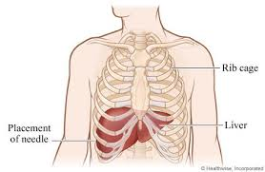
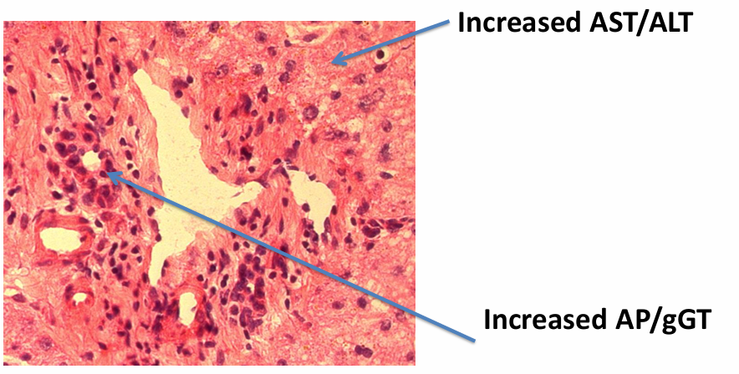
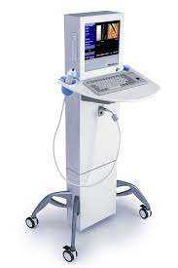
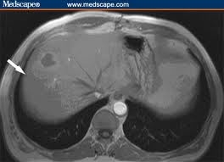
How Do We Investigate Liver Disease?
Liver-related blood tests
Bilirubin
AST / ALT — liver enzymes
ALP / gGT — hepatobiliary enzymes
Albumin
Total protein
Additional investigations
Autoantibodies and antibody titres
Haematology
Viral markers
Metabolic indicators
Tumour markers
Other methods: Imaging and biopsy

Slide 5
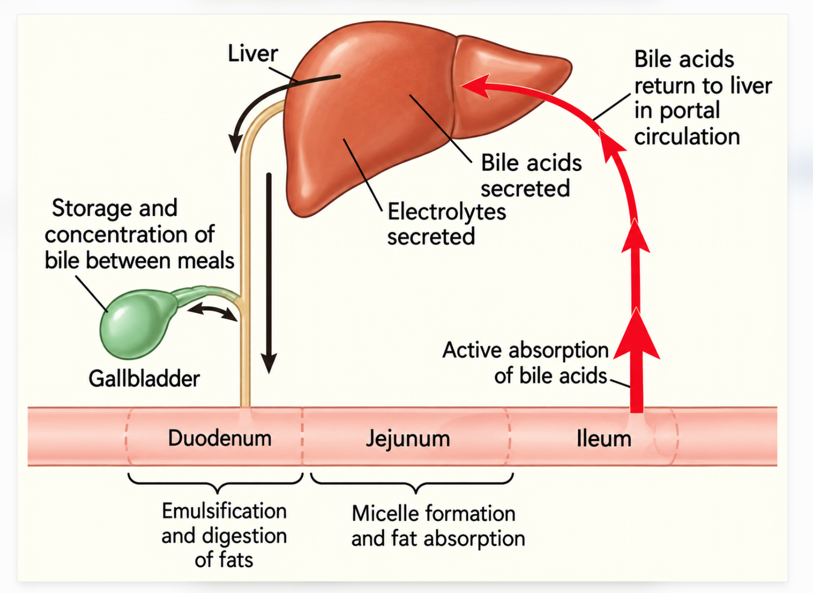
Bile Production
Production of Bile
Approximately 0.5 L produced per day by hepatocytes.
A few hundred millilitres can be stored in the gallbladder.
Bile is released into the intestine when required.
Functions of Bile
Emulsification of fat in the intestine.
Uptake of fat-soluble vitamins: A, D, E and K.
Excretion of substances that cannot be cleared by the kidneys, including cholesterol and bilirubin.
Bile Salt Recycling
Total bile salt pool: approximately 3.5 g.
Bile salts are recycled 6–8 times per day.
Recycling maintains the supply needed for digestion and excretion.
Some bile salts are lost through the faecal route.
Repeated recycling allows the bile salt pool to be reused.

Slide 6
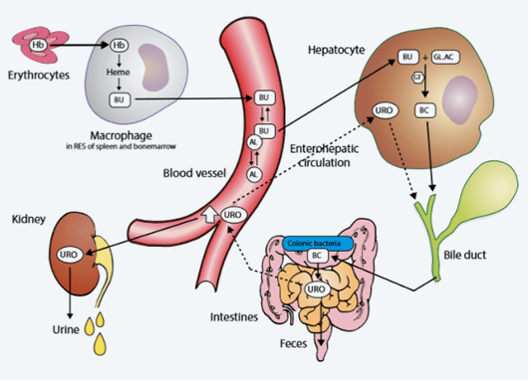
Where Does Bilirubin Come From?
Bilirubin Metabolism
Bilirubin is a product of haem catabolism.
Sources of haem:
Red blood cells
Myoglobin
Cytochromes
Peroxidases
Daily bilirubin production: Approximately 250–300 mg

Slide 7
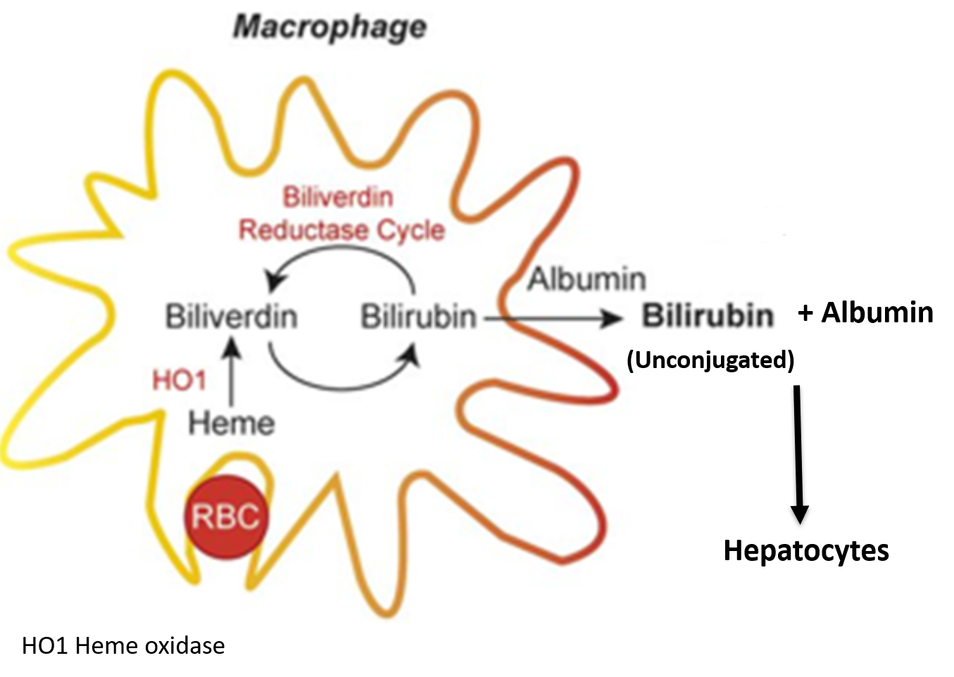
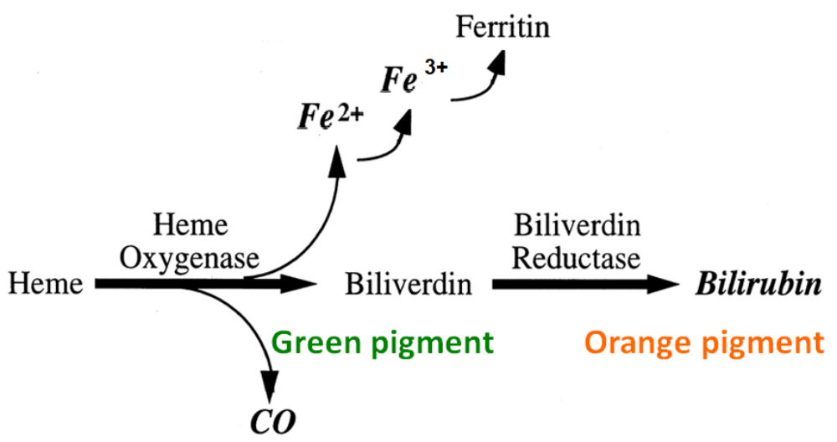
Haem Breakdown in Macrophages
Inside the macrophages

Slide 8
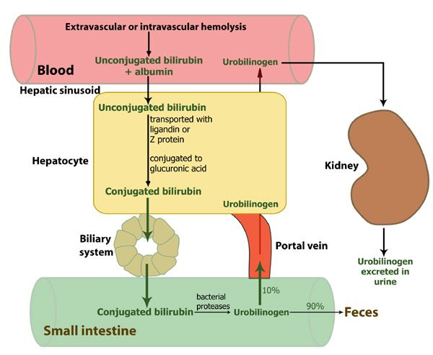
Bilirubin Transport and Conjugation
Unconjugated Bilirubin
Not water-soluble.
Transported to the liver bound to albumin.
Conjugation in the Liver
Occurs in hepatocytes.
Bilirubin is conjugated with glucuronic acid.
Enzyme: UDP-glucuronyltransferase.
Conjugated Bilirubin
Water-soluble.
Can be excreted into bile.

Slide 9
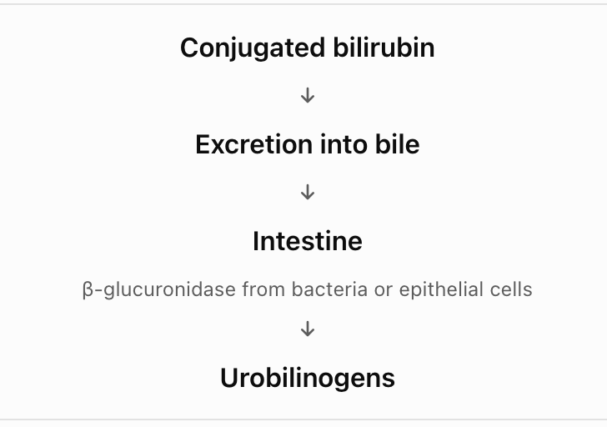
Bilirubin Excretion and Recycling
Fate of urobilinogens
Some are reabsorbed and returned to the liver.
Some are excreted in urine.
https://www.youtube.com/watch?v=dJ_dasmimE4
Time stamp: 1min 20 sec to 8 min 03 sec

Slide 10
Classification of Jaundice
Jaundice can be classified according to where the problem occurs.
Pre-hepatic: Before the liver, Haemolysis
Intrahepatic: Within the liver, Liver injury
Extrahepatic / Post-hepatic: After the liver, Obstructed bile flow

Slide 11
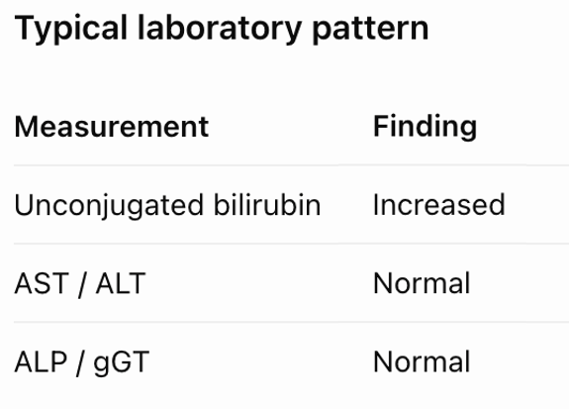
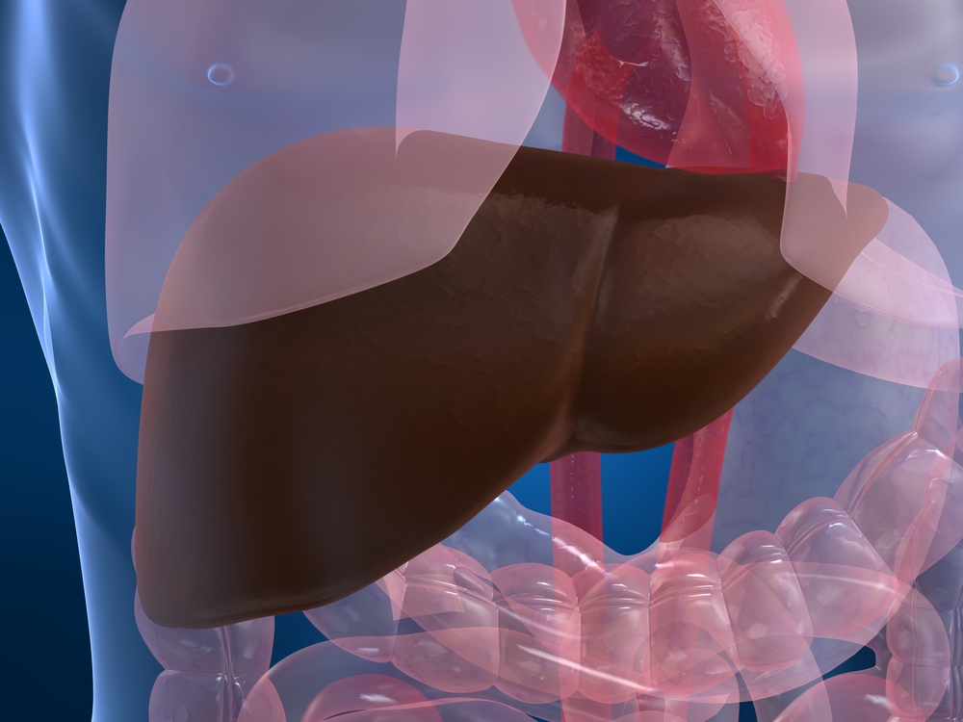
Pre-hepatic Jaundice
Pre-hepatic Jaundice
Main mechanism
Increased haem breakdown
Increased production of bilirubin
Haemolysis
Increased bilirubin does not always indicate primary liver injury.
‘Pre’ Hepatic Jaundice
Haem metabolism
Increased Unconjugated
Bilirubin
Normal AST/ALT
Normal ALP/gGT
Bilirubin
(Unconjugated)
Gilberts’ Syndrome

Slide 12
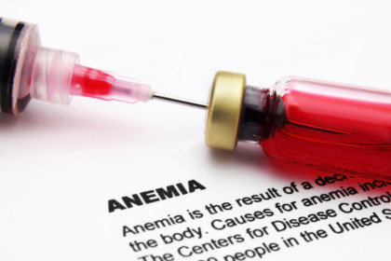
Haemolytic Anaemia and Liver-Related Findings
Haemolytic Anaemia
Examples
Haemolytic anaemia — red blood cell destruction
Paroxysmal nocturnal haemoglobinuria (PNH) — genetic condition associated with fragile RBCs
Sickle cell disease — genetic condition involving variant forms of haemoglobin
Liver-related findings in anaemias
Gallstones
Increased bilirubin
Dark urine
Hepatomegaly
Splenomegaly
Elevated AST / ALT
Thrombosis
Transfusional iron overload
Hepatic thrombosis
Coagulation deficit
Altered MRI signal

Slide 13
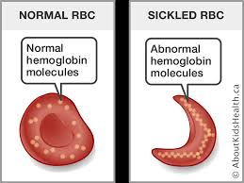
Clinical Example: Sickle Cell Disease
Patient: 41-year-old man with SCD
Presentation
Right upper quadrant pain
Jaundice and fatigue
Abdominal tenderness
Enlarged liver and spleen
Swollen abdomen
Medical history and imaging
Previous cholecystectomy for gallstones
Ultrasound: signs of liver disease and moderate ascites
Gallbladder and spleen absent on imaging
No biliary obstruction
Blood tests
Increased bilirubin
Reduced haemoglobin and haematocrit
Elevated WBC and platelets
Mildly elevated liver enzymes
Reduced albumin and raised INR
Negative viral markers

Slide 14
Clinical Example: Treatment
The diagnosis in this patient was sickle cell intrahepatic cholestasis
Exchange transfusion days
Treatment
Aggressive manual exchange red blood cell transfusion
Target: reduce HbS to below 30%
Fresh plasma
Vitamin K
Treatment aims
Reduce HbS
Correct abnormal INR
Clinical monitoring
Bilirubin
HbS
INR

Slide 15
Gilbert's Syndrome
Cause
Mutation affecting the bilirubin UDP-glucuronyltransferase 1 gene
Reduced bilirubin conjugation
Increased unconjugated bilirubin
Clinical importance
Exclude haemolysis and other liver diseases
Generally benign
Recognition helps avoid unnecessary investigations
Clinical features
Approximately 10% of the Caucasian population
Increased bilirubin during fasting
Bilirubin may also increase during illness or surgery
‘Pre’ Hepatic Jaundice
Haem metabolism
Increased Unconjugated
Bilirubin
Normal AST/ALT
Normal ALP/gGT
Bilirubin
(Unconjugated)
Gilberts’ Syndrome

Slide 16
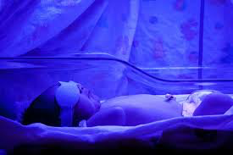
Neonatal Jaundice
Clinical features
Very common in newborn babies
up to 90% of babies
More common in premature babies
Mechanism
- Delayed clearance of bilirubin produced during red blood cell breakdown
Treatment
- Phototherapy
When is it concerning?
Persistent jaundice
Pale stools
Dark urine

Slide 17
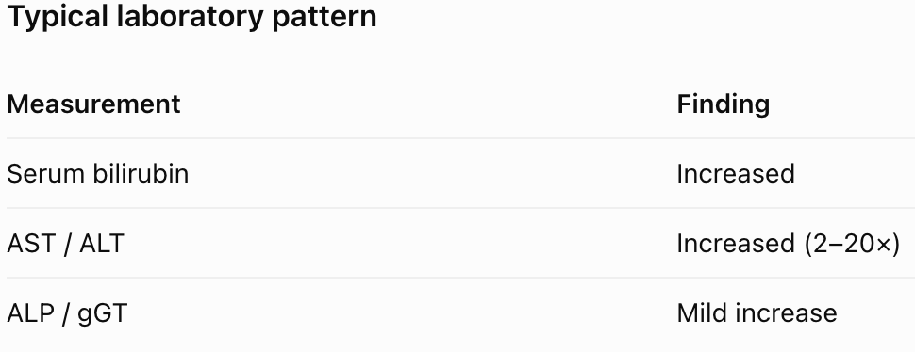
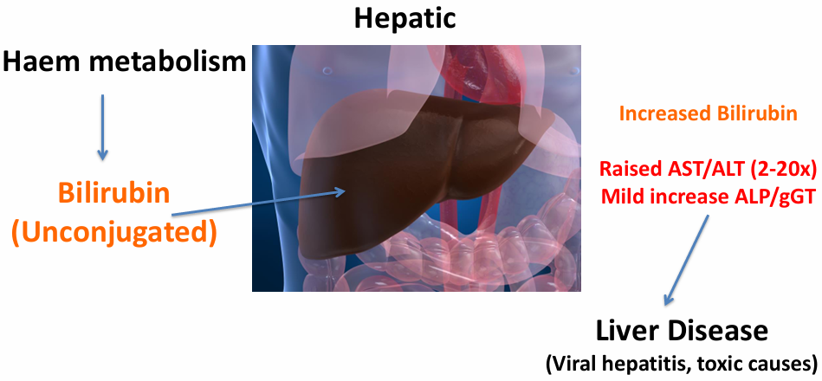
Intrahepatic Jaundice
Mechanism
Damage or dysfunction of hepatocytes.
Impaired processing and excretion of bilirubin.
Both conjugated and unconjugated bilirubin may increase.
Common causes
Acute hepatitis
Chronic hepatitis
Cirrhosis

Slide 18
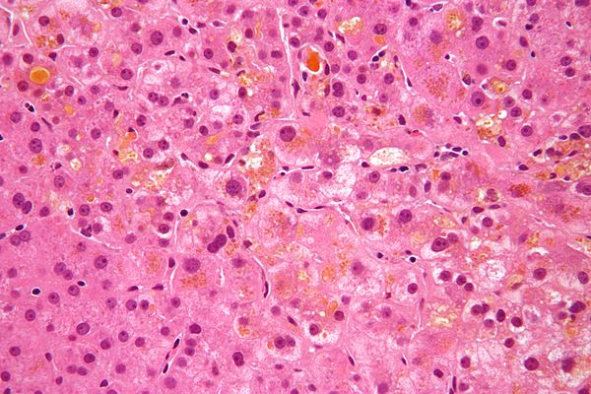
Hepatitis and Liver Cell Injury
Acute causes
Viral hepatitis
Alcohol-related hepatitis
Autoimmune hepatitis
Toxic hepatitis
Chronic causes
Chronic hepatitis
Cirrhosis
Intrahepatic cholestasis
Impaired excretion of conjugated bilirubin
Increased serum bilirubin
Histological example: HBV-associated intrahepatic cholestasis
NB : both conjugated and unconjugated bilirubin might be elevated

Slide 19
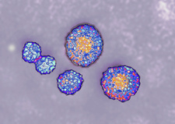
Viral Hepatitis: Mechanism and Clinical Features
Hepatitis viruses
Hepatitis A, B, C, D and E
Infect hepatocytes
Immune responses contribute to liver cell injury
Jaundice does not always occur
Hepatitis A
Faecal–oral transmission
Common in regions with inadequate sanitation
Flu-like symptoms
Nausea and anorexia
Jaundice
Dark urine and pale stools
Hospitalisation is rarely required

Slide 20
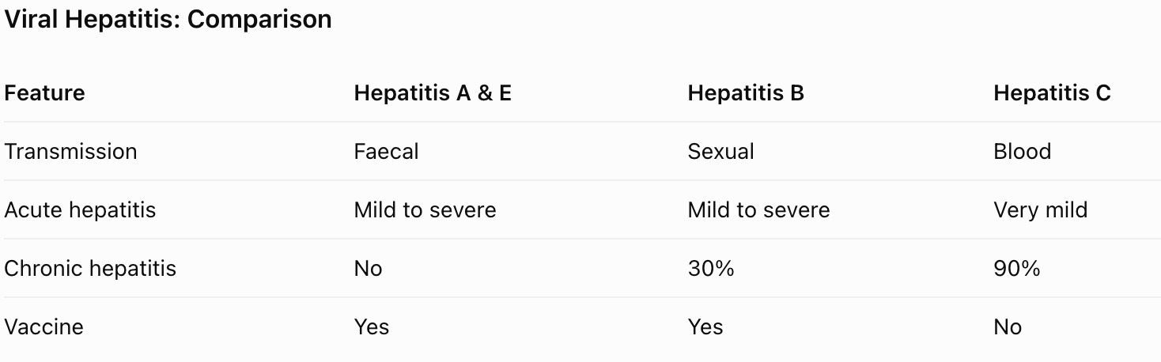
Viral Hepatitis: Comparison of Hepatitis A/E, B and C
Important
Jaundice may be absent.
Jaundice may appear late

Slide 21
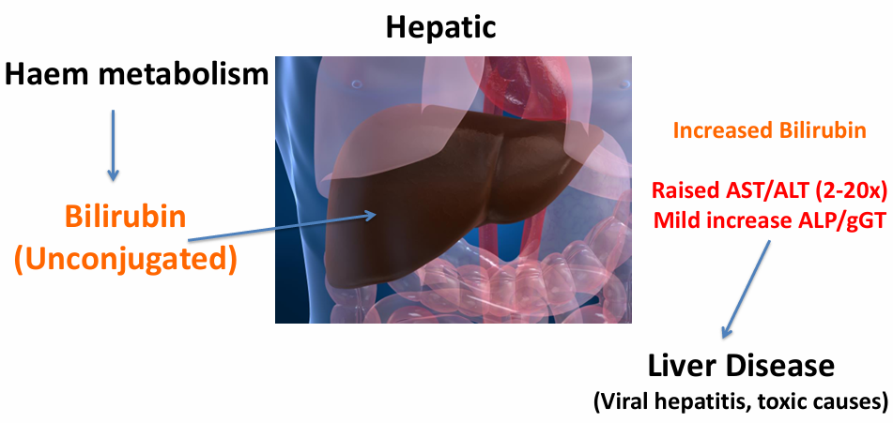
Other Causes of Intrahepatic Cholestasis
Other Causes of Intrahepatic Cholestasis
Cancer
Destruction of small bile ductules
Autoimmune conditions
Drug-related injury
Systemic injury
Pregnancy
Drug toxicity
Intrahepatic cholestasis can arise from different processes within the liver.

Slide 22
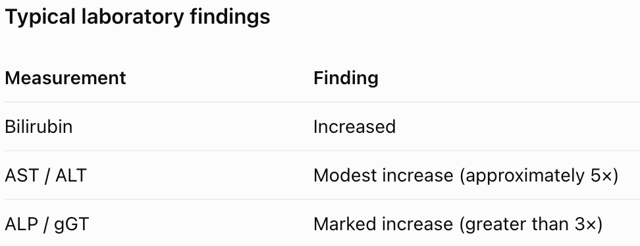
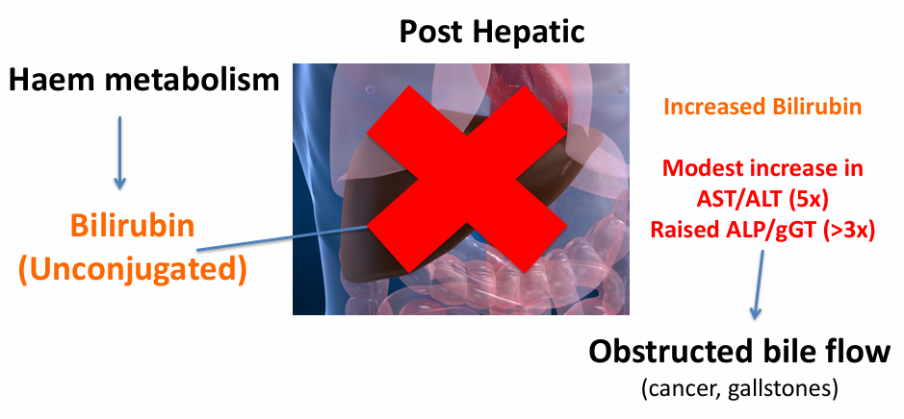
Post-hepatic Jaundice: Mechanism and Laboratory Findings
Post-hepatic Jaundice
Main mechanism
Obstruction of bile flow after bile is produced
Impaired excretion of bilirubin
Increased serum bilirubin
Common causes: Gallstones, bile duct disease, cancer and external compression.

Slide 23
Causes of Biliary Obstruction
Obstruction within the biliary tract
Gallstones
Bile duct inflammation
Bile duct cancer
Compression from outside the biliary tract
Enlarged lymph nodes
Pancreatic cancer
Different diseases can produce a similar pattern of obstructive jaundice.

Slide 24
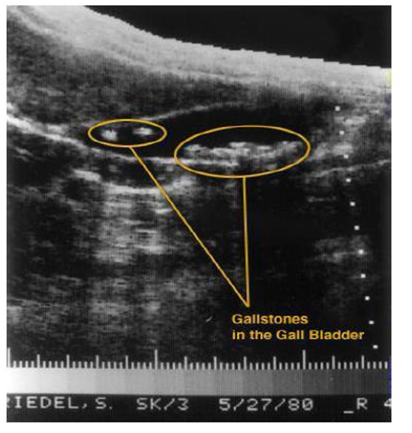
Gallstones
Frequency
Women: 20–30%
Men: 10–20%
Age group: 50–60 years
Clinical features
Most gallstones are asymptomatic.
Gallstones arise from an imbalance in bile constituents.
Migration of stones may cause biliary obstruction.
Possible complications
Jaundice
Cholangitis

Slide 25
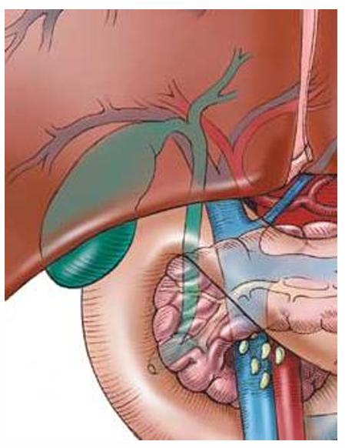
Pancreatic Cancer
Mechanism
Tumour may obstruct the lower common bile duct.
Bile flow becomes impaired.
Bilirubin accumulates.
Typical clinical presentation
Painless jaundice
Weight loss
More common in older patients
Clinical significance
- Poor prognosis

Slide 26
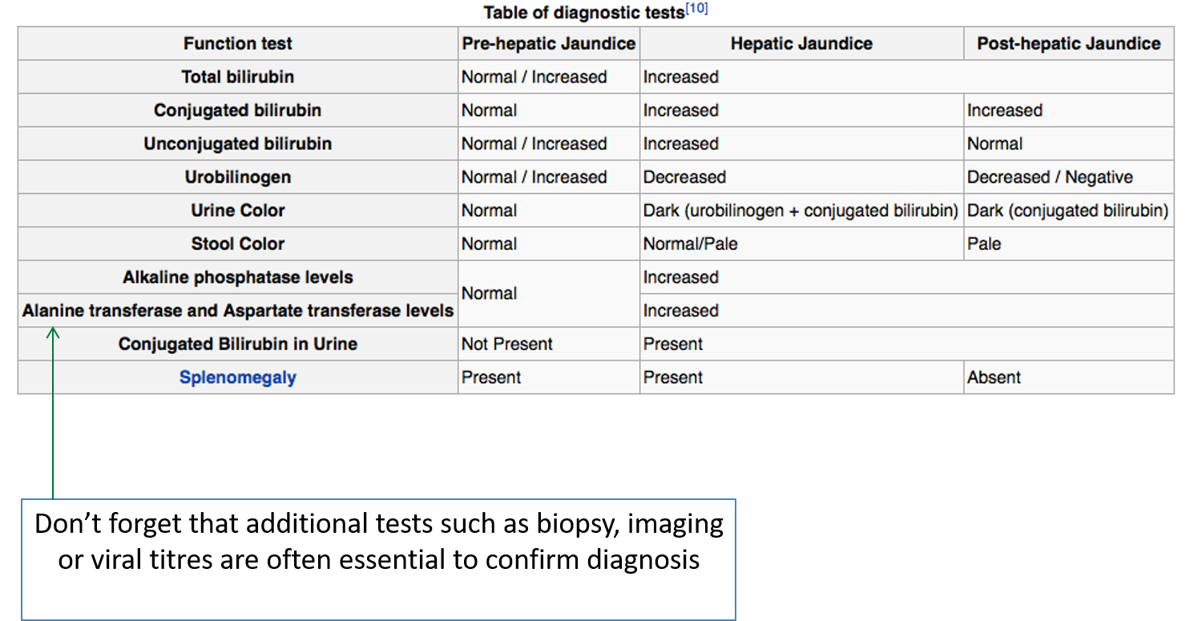
A useful summary to aid differential diagnosis

Slide 27
In summary :
We have introduced some tests which may indicate presence of liver disease
We discussed the metabolism and recycling of bilirubin
This was then linked to what happens in serum and how you can measure bilirubin as a clue to whether someone has jaundice due to liver disease
Remember its hard to decide what type of liver disease someone has just because they have jaundice – other tests are required

Slide 28
Case Study

